Slide 1
BB2950 Day 27: Thursday 12-14-17
Learning objectives:
Explain how phosphorylation can regulate a transcriptional activator.
Explain how sub-cellular localization can regulate a transcriptional activator.
Describe the relationship between chromatin structure and transcription in eukaryotes, and explain some of the ways in which chromatin structure is controlled.
Conceptualize the connections between many of the topics we have covered in this course.

Slide 2
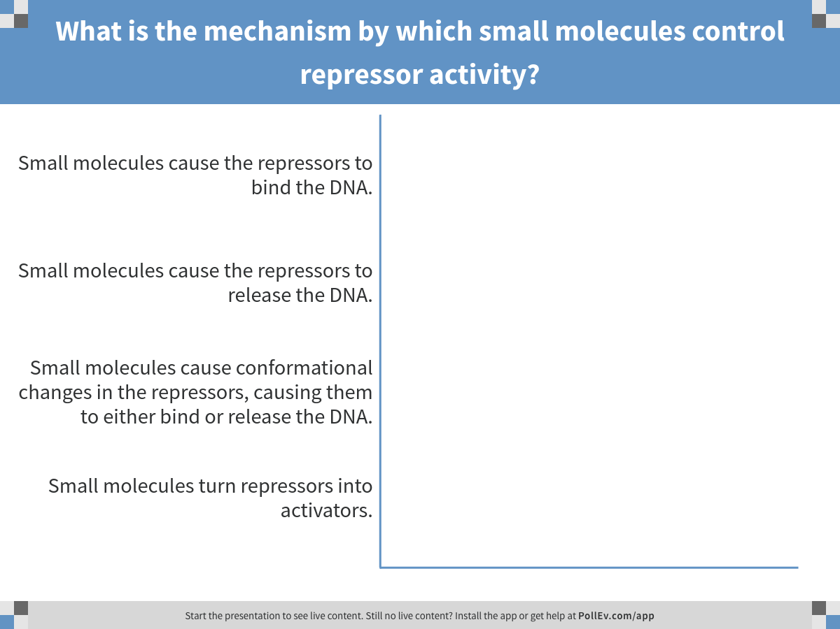
Notes:
What is the mechanism by which small molecules control repressor activity?
https://www.polleverywhere.com/multiple_choice_polls/5FO3brJcuXB5AE6

Slide 3
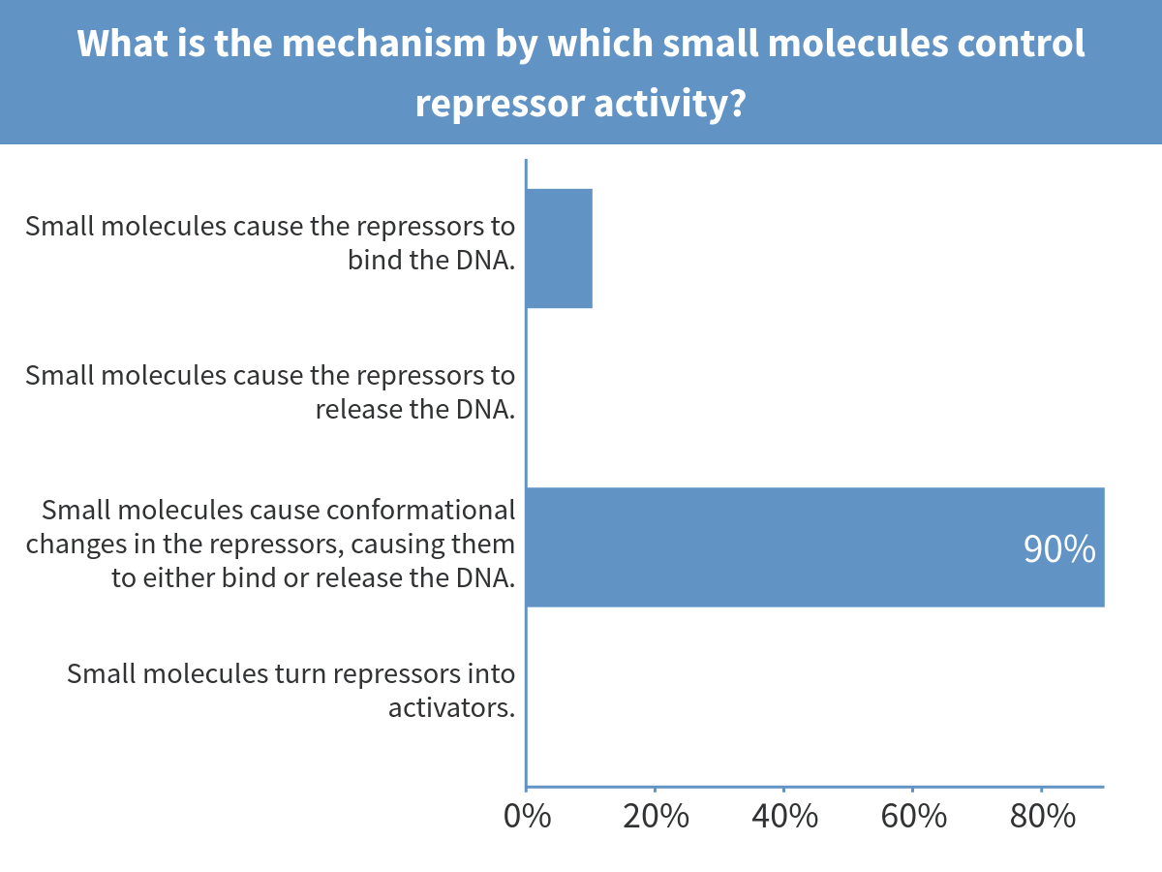
Notes:
What is the mechanism by which small molecules control repressor activity?

Slide 4
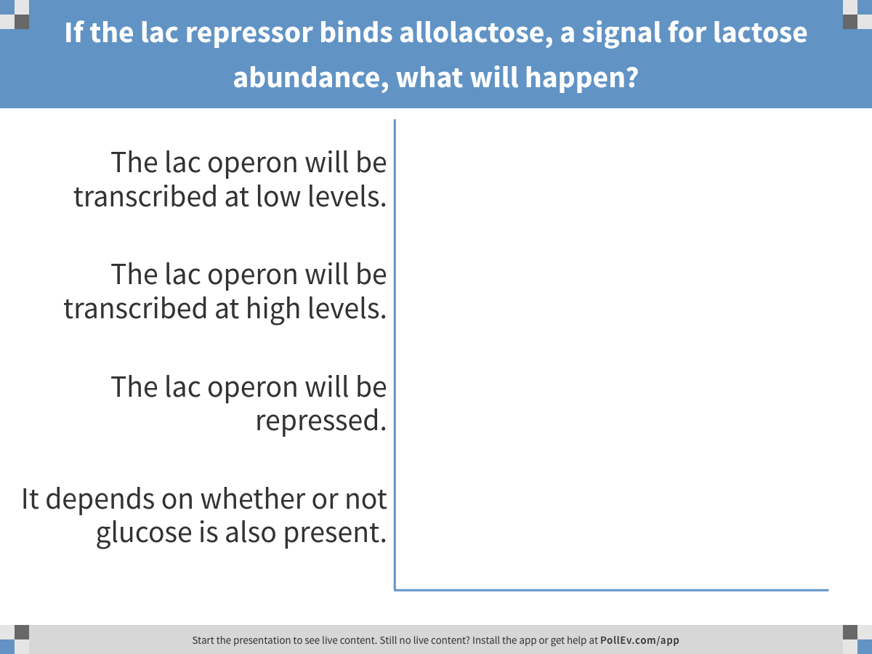
Notes:
If the lac repressor binds allolactose, a signal for lactose abundance, what will happen?
https://www.polleverywhere.com/multiple_choice_polls/cPz0KFlStwlZpek

Slide 5
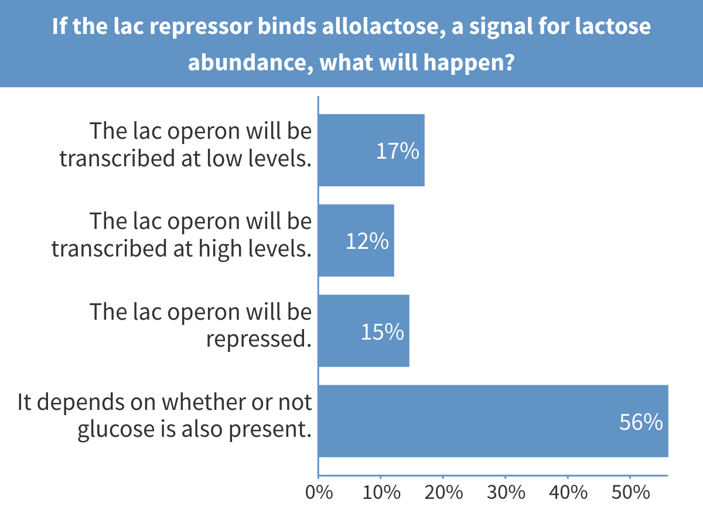
Notes:
If the lac repressor binds allolactose, a signal for lactose abundance, what will happen?

Slide 6
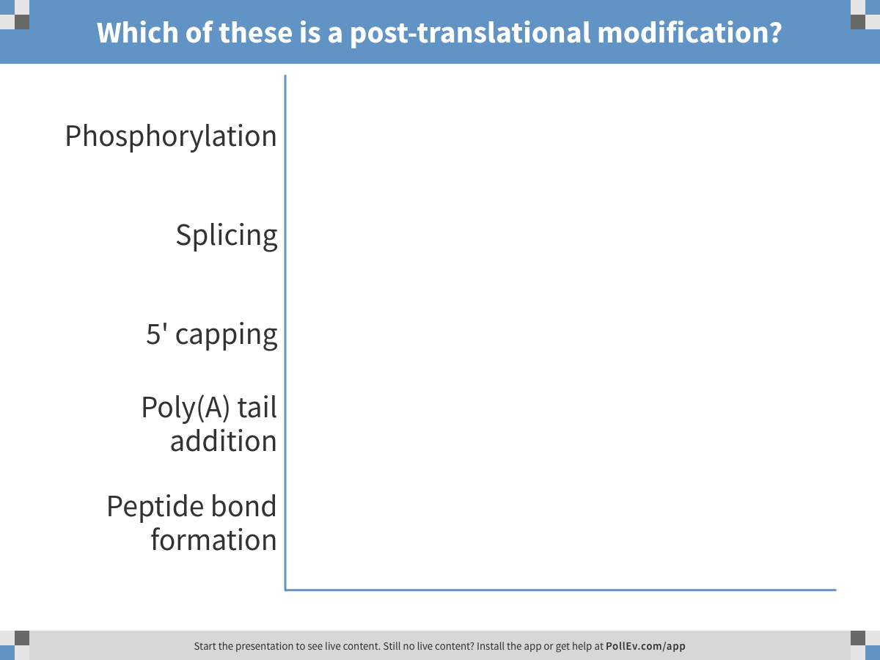
Notes:
Which of these is a post-translational modification?
https://www.polleverywhere.com/multiple_choice_polls/gk84X7wL1t8XciZ

Slide 7
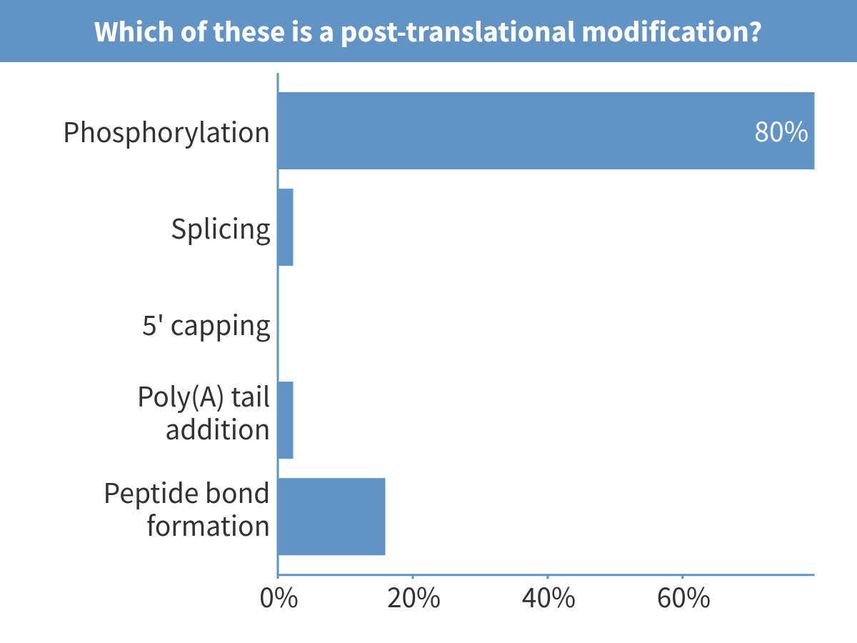
Notes:
Which of these is a post-translational modification?

Slide 8
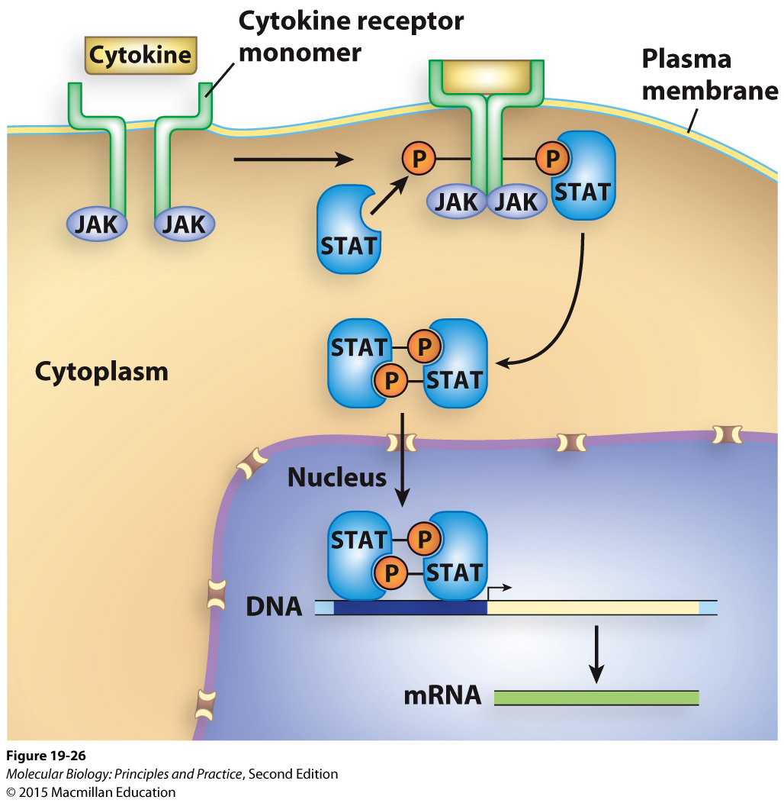
An example of regulation of a transcriptional activator by phosphorylation and localization

Slide 9
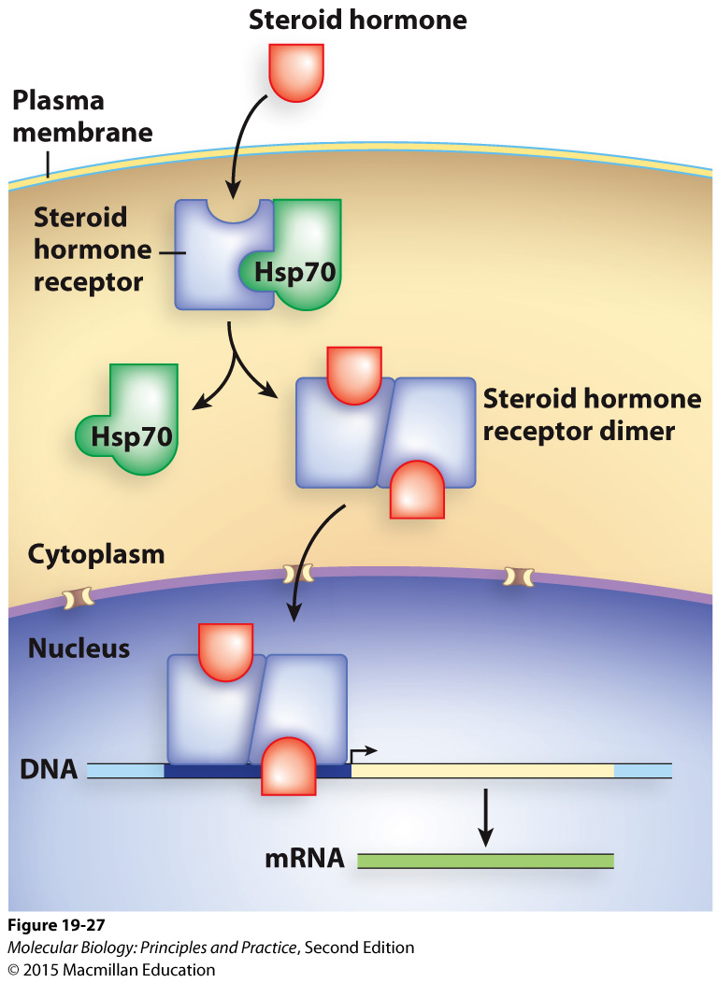
An example of regulation of a transcriptional activator by effector binding and localization
Notes:
Indicate what is a protein and what is a small molecule.

Slide 10
Eukaryotic transcription is strongly affected by chromatin structure

Slide 11
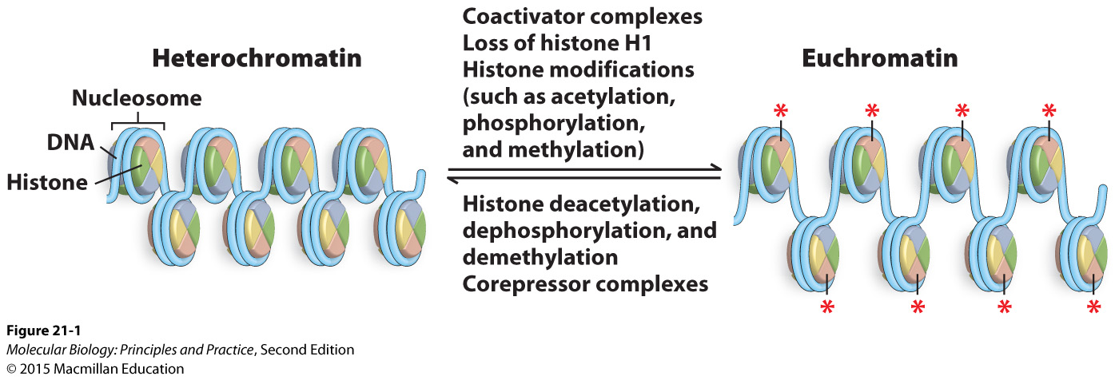
Eukaryotic transcription is strongly affected by chromatin structure

Slide 12
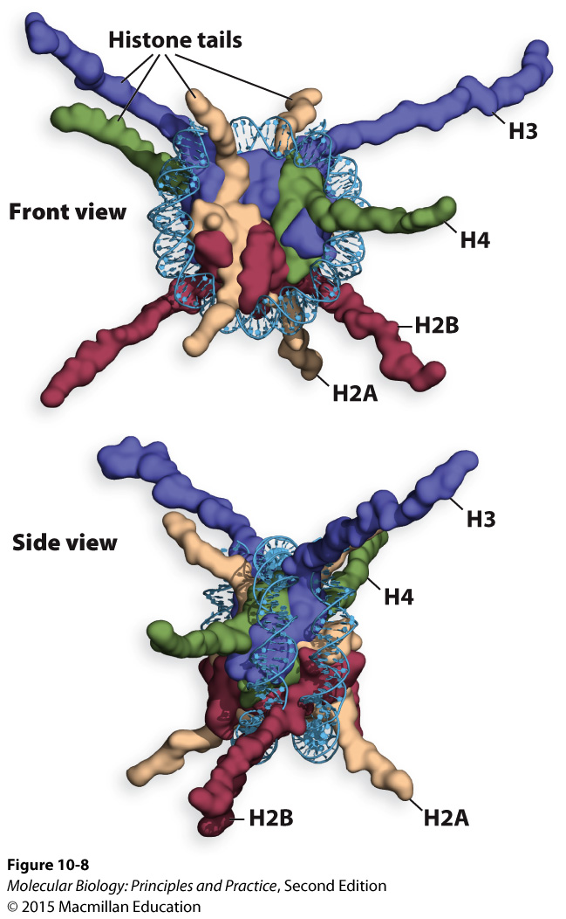
Histone tails contribute to the formation of higher-order chromatin structure and regulation of transcription
Histones must be removed for transcription to occur
Tails are often post-translationally modified

Slide 13
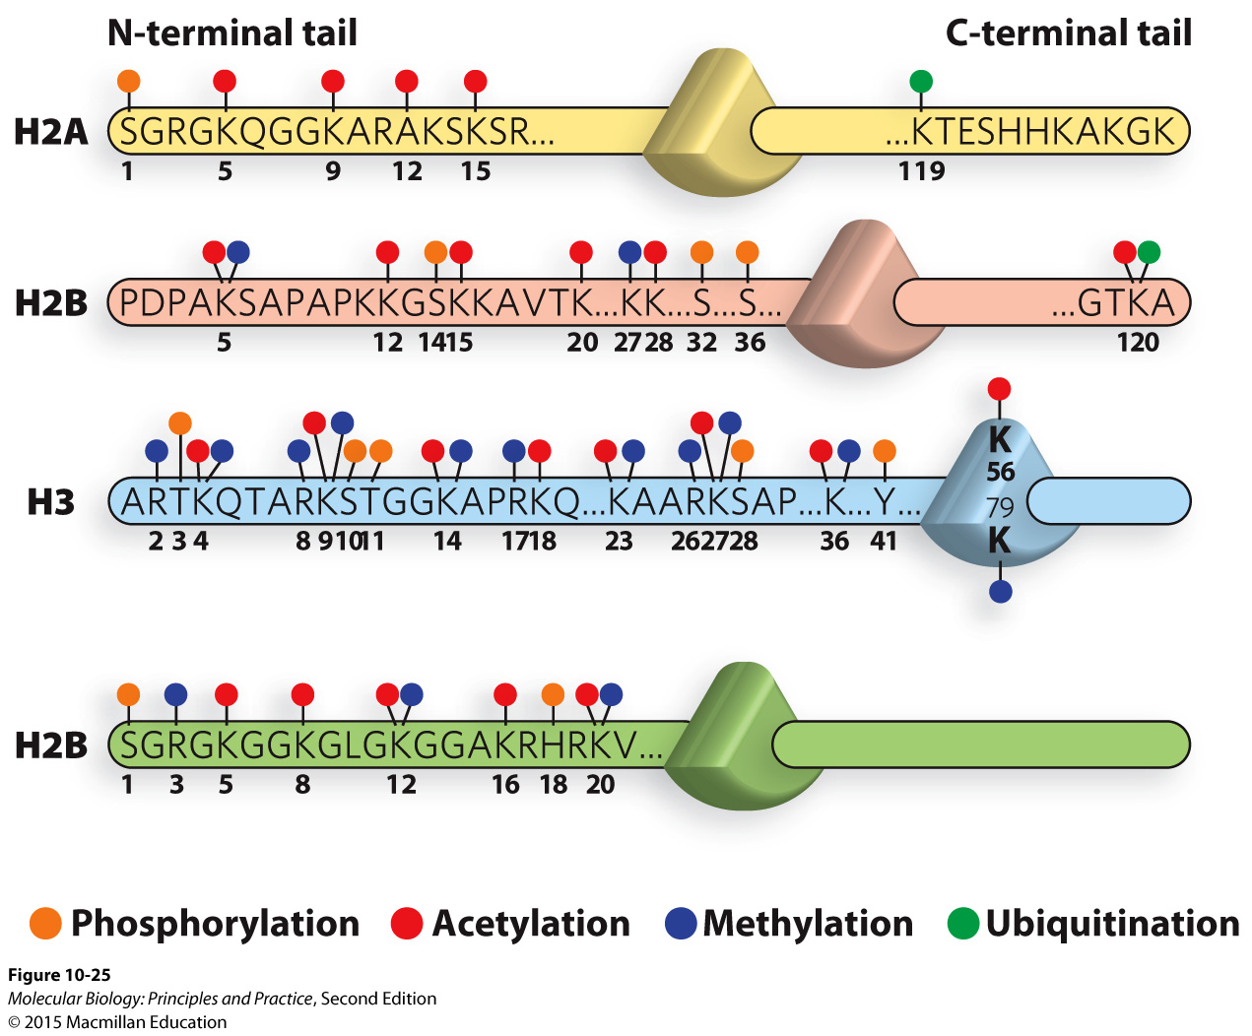
Many possible histone modifications create a complex “code”
H4

Slide 14
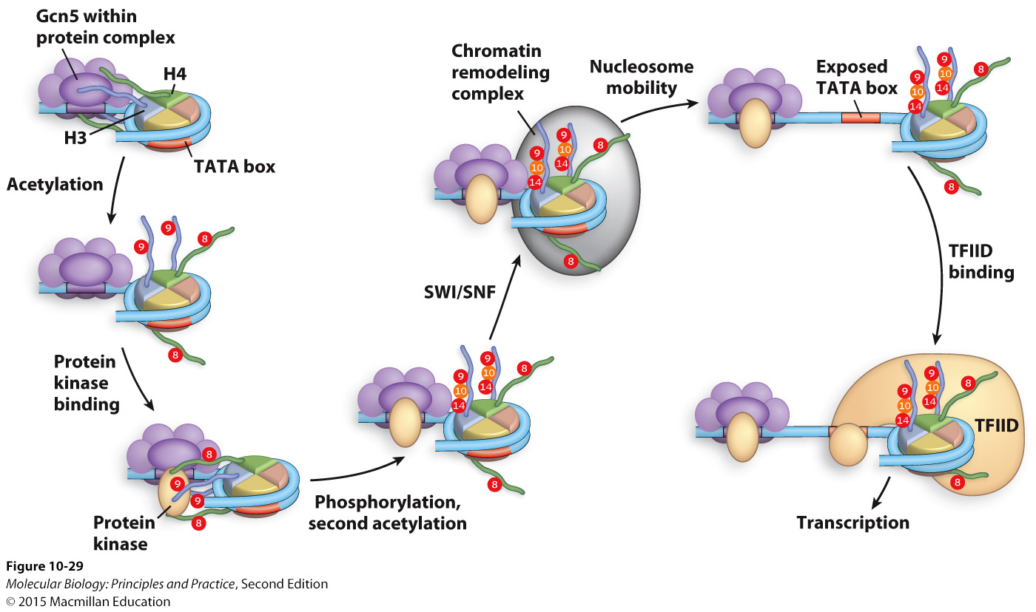
An example of histone modifications leading to transcription

Slide 15
The relationship between chromatin remodeling and transcription
Notes:
Histone tails are modified
Chromatin remodeling complexes move histones/nucleosomes
Promoter and enhancer sequences are exposed, permitting transcription.
OR histone tails are modified in ways that cause tighter binding/repress transcription.

Slide 16
Prokaryotes have less compact chromatin and therefore usually don’t require chromatin remodeling for transcription to occur

